Slide 1


PETRONAS Advanced Analytics Framework for Resource Optimization (PETRO-AFRO)
AI-Assisted Relative Permeability Composer – Data Extraction & Data Preparation
Project Leader: Dr. Ervin Gubin Moung
Institution: Faculty of Computing and Informatics, Universiti Malaysia Sabah
26 February 2026 Research Assistants:
Afif Muizzuddin
Valentino Liaw

Slide 2
Last Meeting Recap
Key Takeaways ( 5 February 2026):
1. Baseline extraction benchmark established: Full-document extraction (17 pages) using default prompt → ~40 minutes runtime; confirmed JSON output consistency but incomplete table capture on complex pages.
2. Targeted page selection validated: Extracting only relevant pages (6–8) reduced runtime (~30 minutes total) while maintaining similar extraction quality.
3.Task-specific prompts showed mixed performance: Capillary-pressure/rel-perm prompts improved extraction on relevant pages but failed when keywords were absent or table structure differed.
4. Prompt length significantly impacts accuracy: Longer, rule-based general prompts improved extraction completeness (especially on low-quality scans), but increased runtime (≈2× longer).
5. Strict context-driven prompts improved structure but risked over-filtering: Enhanced normalization and column enforcement improved row completeness but sometimes excluded valid data.
6. Table structure strongly affects model behavior: Clear tabular layouts performed well; blurred scans, handwriting, and irregular formatting reduced extraction accuracy.
7. Runtime remains a critical bottleneck: 3-page runs ≈20 minutes on local GPU; performance likely constrained by image reasoning load — HPC testing required.
8. Model reasoning remains opaque (“black box” effect): No chain-of-thought visibility; difficult to diagnose why certain prompts succeed or fail.
9. Strategic direction refined: Shift from generic “extract-all tables” to specific-use-case-driven extraction, such as: • Extract all porosity values per core sample • Extract capillary pressure curves • Digitize graph data points • Target specific SCAL parameters only
10. Future exploration planned: • Targeted prompt refinement • Accuracy vs runtime benchmarking • Graph digitization experiments • Agentic Document Extraction (ADE) workflows • HPC deployment testing

Slide 3
Work Direction Based on Last Meeting
Following the direction from the last two weeks of meetings, the current work is structured into three steps:
Prompt Refinement Using a stable default prompt that is performance efficient in terms of processing speed vs accuracy.
Extracting pages with Graphs Exploring techniques or prompts to extract information from complex graphical figures.
Developing working Agentic Document Extraction (ADE) workflows
Integrating various tech stacks that works as agents to improve and refine the extraction of data from documents. From classifying pages, prompt optimizations, anchor prompt builder, OCR+VLM, LLM-Post Processing etc.
Specific Use-Case Promptings -Use insights from general extraction to design focused, use-case-specific extraction workflows that are more accurate, faster, and easier to validate.
-Conduct multiple finetuning process to identify the proper prompts for specific use cases

Slide 4
Specific Use-Case Prompting Conduct multiple finetuning process to identify the proper prompts for specific use cases.
Target Specific SCAL Parameters
Graph Digitization
Extract Specific column only

Slide 5
Specific Use-Case 1
(Target Specific SCAL Parameters)

Slide 6
Experiment Summary Table
Exp ID | Prompt Strategy | Page Selection Strategy | What Is Varied | Primary Objective | Exp Outcome
Exp 1 | Default generic prompt + specify Table title specify | All pages | Prompt | Target Specific Table | • Total rows: 65 • Duration: 8954.7s / 149.245minutes The exp is able to extract table but all data table was extracted.
Exp 2 | Default generic prompt + specify Table title specify | Manually selected pages | Pages Selection | Target Specific Table and Reduce runtime | • Total rows: 24 • Duration: 3740.5s / 62.34minutes The exp is able to extract table but all data table was extracted. Same result as experiment 1
Exp 3 | Updated prompt for Table Extraction for using keyword | All pages | Updated Prompt | Target Specific Table | • Total rows: Unable to capture due to remote connection lost • Duration: Unable to capture due to remote connection lost The exp is able to extract the required table with the required information. However certain output format can be improved especially with regards to brine saturation data.
Exp 4 | Updated prompt for Table Extraction for using keyword | All pages | New pdf file (Duyong Deep-1) | Target Specific Table | • Total rows: 47 • Duration: 11073.0s / 184.55m The exp is able to extract the required table with the required information (keyword:PSI).
Exp 5 | Updated prompt for Table Extraction for using keyword ❌wrong prompt | Same pages | New pdf file (Pegaga-2 RealPerm) | Target Specific Table | •Total rows: 49 • Duration: 7996.6s / 133.2767m The exp only manage to capture table in page 16. The extracted value format using scientific notation is also not constant.
Exp 6 | Updated prompt for Table Extraction for using keyword ❌wrong prompt | Same pages | New pdf file (Pegaga-2 RealPerm) | Target Specific Table | •Total rows: 15 • Duration: 4070.0s / 67.83m Unable to extract data table using keyword “krw”
Exp 7 | Updated prompt for Table Extraction for using keyword | All pages | New pdf file (Pegaga-2 RealPerm) | Target Specific Table | • Total rows: 26 • Duration: 8710.5s / 145.175m Able to extract all table with keyword “krw” but missing the last page tables

Slide 7
Experiment Outcome
Based on Use-Case 1 Purpose, the extraction of certain table within a pdf file that contains multiple tables, a specific Use-Case Prompt has been identified that is able to extract a table based on a “keyword”.
Target table Specific SCAL Parameters prompts
I need you to extract a specific table from this PDF document. The document contains multiple tables, but I'm only interested in the table that contains the keyword "[keyword]".
Please follow these steps:
1. Scan through all tables in the document
2. Identify the table that contains the keyword "[keyword]"
3. Extract the complete table including all headers, rows, and columns
4. If table present, extract ALL rows in exact order with exact column names as JSON array
5. Extract data ONLY if table present. If no table: {"no_table": true}

Slide 8
Specific Use-Case 2
(Graph Digitization)

Slide 9
Version Limitation
❌ Unfortunately, due to model and version limitation, the current program is unable to tabulate data based on given graph.
The current version is missing a certain modules on extracting tabulation data from graph.

Slide 10
Specific Use-Case 3
(Extract Specific column only)

Slide 11
Experiment Summary Table
Exp ID | Prompt Strategy | Page Selection Strategy | Documents | Primary Objective | Exp Outcome
Exp 1 | Simple prompt to extract Sample ID and Core Sample | All Pages | Pegaga-2 RealPerm | Target Specific column only | •Total rows: 0 • Duration: n/a Failed to extract any data
Exp 2 | Updated Specific Prompt | Manually selected pages | Duyong Deep-1 | Target Specific column only | • Total rows: 0 • Duration: n/a Failed to extract any data
Exp 3 | Updated Specific Prompt | Manually selected pages | A3.1 | Target Specific column only | • Total rows: 0 • Duration: n/a Failed to extract any data

Slide 12
Experiment Ongoing
Based on Use-Case 3 Purpose, the extraction of certain column within a table is still unable to be completed because we still have not found the correct prompt to use.
Prompt 1
Prompt 2
Please identify all table in the file.
after that, extract all porosity values per core sample or sample ID.
Extract data from the table in this document.
Target columns (by description, not name):
[“Sample Core or Sample ID"]
2. [“Porosity Value"]
How to identify these columns:
Column 1: [By name]
Column 2: [By name]
Extract these two columns only.
Output as: [Sample ID] | [Porosity value]

Slide 13
Experiment Ongoing
Prompt 3
I need you to extract specific data from a table in this document.
Table identification: [“First Table in the page"]
What I need to extract:
- Column A: [“Sample ID"]
- Column B: [“Helium Porosity "]
Column identification guidance:
For Column A, look for:
- [Data characteristics, e.g., "alphanumeric codes“]
- [Value patterns, e.g., “unique for each row’”]
- [Position hints, e.g., "usually the first column“]
For Column B, look for:
- [Data characteristics, e.g., "numeric values “]
- [Value patterns, e.g., "decimal numbers"]
- [Position hints, e.g., "usually the column placed in the middle"]
Task:
1. Identify the table
2. Determine which columns match the descriptions above
3. Extract only those columns for all rows as JSON array
4. Ignore all other columns

Slide 14
Agentic Document Extraction (ADE)
LandingAI framework — docs.landing.ai/ade/ade-overview | github.com/landing-ai/ade-helper-scripts
What is ADE?
Agentic Document Extraction (ADE) is a document intelligence pipeline that converts unstructured documents — PDFs, scans, images — into reliable, structured, machine-readable data suitable for RAG, search, and ML applications.
Core ADE Pipeline (LandingAI):
Parse
Converts documents to structured Markdown + JSON chunks. Each chunk (text, table, figure) gets page number and bounding box coordinates.
Split (optional)
Separates multi-document files into individual documents by type (e.g., batch KYC packages).
Extract
Schema-based field extraction — define field names, API returns matching values from parsed content.
Benchmark accuracy: 99.16% on DocVQA dataset (LandingAI, 2025)
Key Features
✓ Layout-agnostic parsing
Works out-of-the-box — no templates or training needed
✓ Element detection
Text, tables, images, form fields, barcodes — all detected
✓ Visual grounding
Bounding box + page number per chunk for traceability and compliance
✓ Hierarchical understanding
Reading order and element relationships preserved across pages
✓ Schema-based field extraction
Define field names — API extracts matching values automatically
✓ Flexible output
Markdown (human-readable) + JSON (programmatic access)
✓ Multi-file type support
PDF, images, presentations, spreadsheets, text documents
✓ Multi-language support
Parses documents in many languages
✓ Cloud API / scalable
REST API, async batch jobs, AWS Lambda, Snowflake compatible

Slide 15
ADE Comparison: LandingAI vs Our olmOCR ADE Pipeline
Key differences across access model, infrastructure, capabilities, and data privacy
Dimension | LandingAI ADE | Our olmOCR ADE (PETRO-AFRO)
Access model | Cloud API — paid credits, internet required | Fully offline — on-premise GPU, no external dependency
Core model | Proprietary DPT-2 (LandingAI closed model) | allenai/olmOCR-2-7B-1025-FP8 (open weights)
Model quantization | Unknown — proprietary | FP8 via compressed-tensors — ~7 GB VRAM
Input image handling | Handled internally by the API | 1288 px longest dimension (pdftoppm -scale-to 1288)
Prompting strategy | Schema-driven JSON field definitions | olmOCR v4 YAML prompt + LLM Prompt Optimizer agent
OCR output format | Markdown + JSON chunks + bounding boxes | Markdown + YAML front matter (language, rotation, is_table, is_diagram)
Table extraction | Native structured HTML/Markdown tables | HTML <table> in markdown; rendered as Treeview in GUI
Figure handling | Description + bounding box coordinate chunk | Alt-text label + page_x_y_w_h.png filename
Post-processing | ADE Extract API (schema-based, cloud call) | PostProcessAgent — local / Groq / OpenAI LLM, anti-hallucination
Export formats | JSON only | JSON + Excel (.xlsx) + CSV
User interface | None — API calls only | Full tkinter GUI with preview, extract, post-process, export
Cost | Per-page credit subscription | Hardware only (GPU power)
Data privacy | Data leaves premises — sent to LandingAI servers | Data stays entirely on-premise
Graph digitization | Bounding box only — no data point extraction | Same limitation (VLM model constraint, FP8 version)
Fine-tuning | Not possible — closed model | Planned — domain-specific SCAL corpus fine-tuning

Slide 16
olmOCR: Original vs Our ADE Version
Technical parameter comparison — model, inference backend, pipeline, and interface
Parameter | Original olmOCR | Our olmOCR ADE (PETRO-AFRO)
Model variant | olmOCR-7B (FP32 / BF16) | olmOCR-2-7B-1025-FP8
VRAM required | ~14 GB | ~7 GB (FP8 quantization via compressed-tensors 0.12.2)
Processor / tokenizer | Qwen2.5-VL-7B-Instruct | Same
Inference backend | vLLM (batch server, production-optimised) | HuggingFace Transformers (single GPU, interactive)
PDF rendering | pdftoppm via pipeline wrapper | Direct pdftoppm subprocess — temp file — read back — delete
Image resolution | 1288 px longest dimension | Same (pdftoppm -scale-to 1288 flag)
Base prompt | build_no_anchoring_v4_yaml_prompt() | Same base + LLM Prompt Optimizer (system-constrained)
Decoding strategy | Greedy (temperature = 0.0, do_sample = False) | Same — matches official pipeline, faster
Max new tokens | 8000 | Same
YAML front matter | primary_language, is_rotation_valid, rotation_correction, is_table, is_diagram | Same
Anchor text | No anchoring (v4 prompt — no pdftotext context) | Same
Page selection | All pages, batch run | User selects pages via checkboxes — selective extraction
Post-processing | None — raw text output only | PostProcessAgent (LLM) — full document → structured JSON records
Table rendering | None | HTML <table> → Treeview grid in GUI (Rendered Tables tab)
Export | JSON (pipeline output) | JSON + Excel (.xlsx) + CSV — with metadata sheet
User interface | CLI / pipeline script | tkinter GUI — document preview, extract, post-process, export
Timing / tokens | Logged per batch | Per-page duration (s) and token count in Page Timings tab

Slide 17
Extraction Results — Angsi 1 Core
Document: CORE ANALYSIS REPORT, ANGSI WELL NO.1 (ESSO Exploration Malaysia, 1974/1976) | 17 pages extracted
Page | Duration (min) | Tokens | Content Summary
1 | 0.94 | 1,725 | Cover page — document title, authors, date
2 | 0.69 | 1,691 | Cover page — report header
3 | 0.95 | 1,804 | Cover page — report title block
4 | 1.77 | 1,791 | Report details — author, division, date, confidentiality notice
5 | 1.49 | 1,764 | Table of Contents — Tables I, II, III; Figures 1–9
6 | 13.29 | 2,726 | TABLE I — Porosity & Permeability Data (12 core samples, 6 columns)
7 | 12.94 | 2,512 | TABLE II — Centrifuge Gas-Oil Capillary Pressure Data
8 | 15.88 | 2,878 | TABLE III — Electrical Property Measurements (4 cores: AN-28, AN-29, AN-32, AN-38)
9 | 1.92 | 1,797 | Figure 1 — Capillary Pressure Curve (Core AN-30, 8015 ft)
10 | 2.04 | 1,803 | Figure 2 — Capillary Pressure Curve (Core AN-36, 8037 ft)
11 | 2.10 | 1,809 | Figure 3 — Capillary Pressure Curve (Core AN-37, 8038 ft)
12 | 1.83 | 1,798 | Figure 4 — Capillary Pressure Curve (Core AN-39, 8040 ft)
13 | 2.28 | 1,841 | Figure 5 — Resistivity Ratio vs Sw (Core AN-28, Desat. Exp. 2.11)
14 | 2.31 | 1,843 | Figure 6 — Resistivity Ratio vs Sw (Core AN-29, Desat. Exp. 2.01)
15 | 4.05 | 2,011 | Figure 7 — Resistivity Ratio vs Sw (Core AN-32, Desat. Exp. 1.94) — table inside figure
16 | 2.46 | 1,856 | Figure 8 — Resistivity Ratio vs Sw (Core AN-38, Desat. Exp. 2.45)
17 | 1.15 | 1,731 | Figure 9 — Formation Factor vs Porosity (Cementation Factor 2.06)
TOTAL: 17 pages | 4,086.5 s (~68.1 min) | 33,380 tokens | 3 data tables (HTML) | 9 figures labeled | Complex table pages (6–8) took 12.9–15.9 min each due to large token output

Slide 18
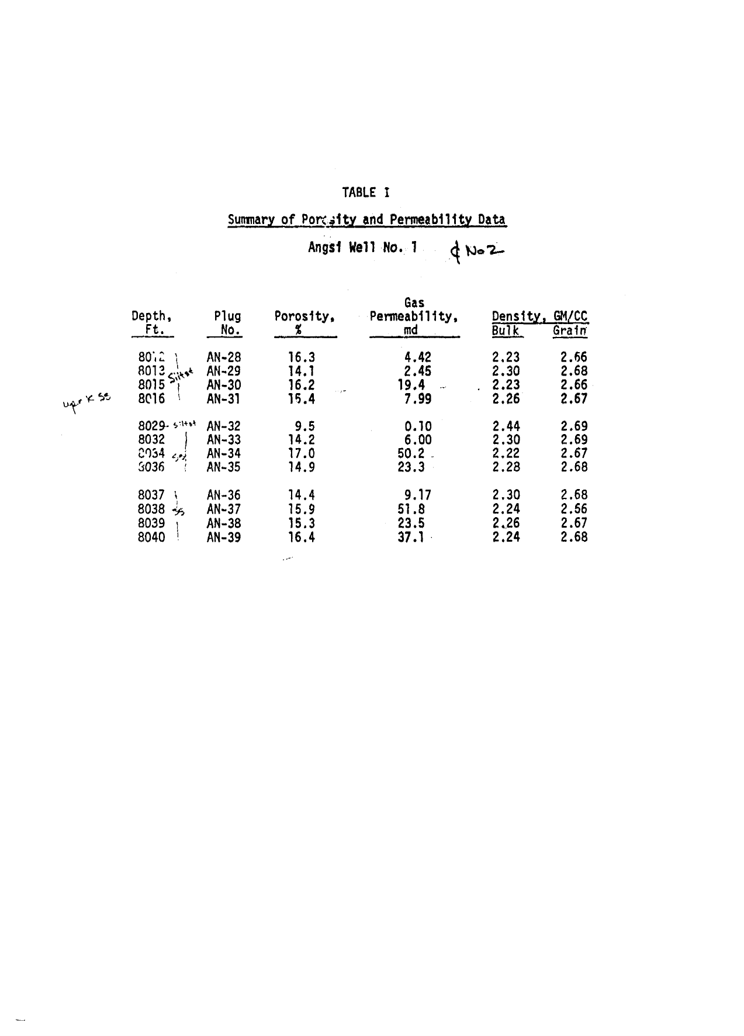
Extracted Page 6 — TABLE I (Porosity & Permeability)
Core samples: AN-28 through AN-39 | Duration: 13.29 min | Tokens: 2,726

Slide 19
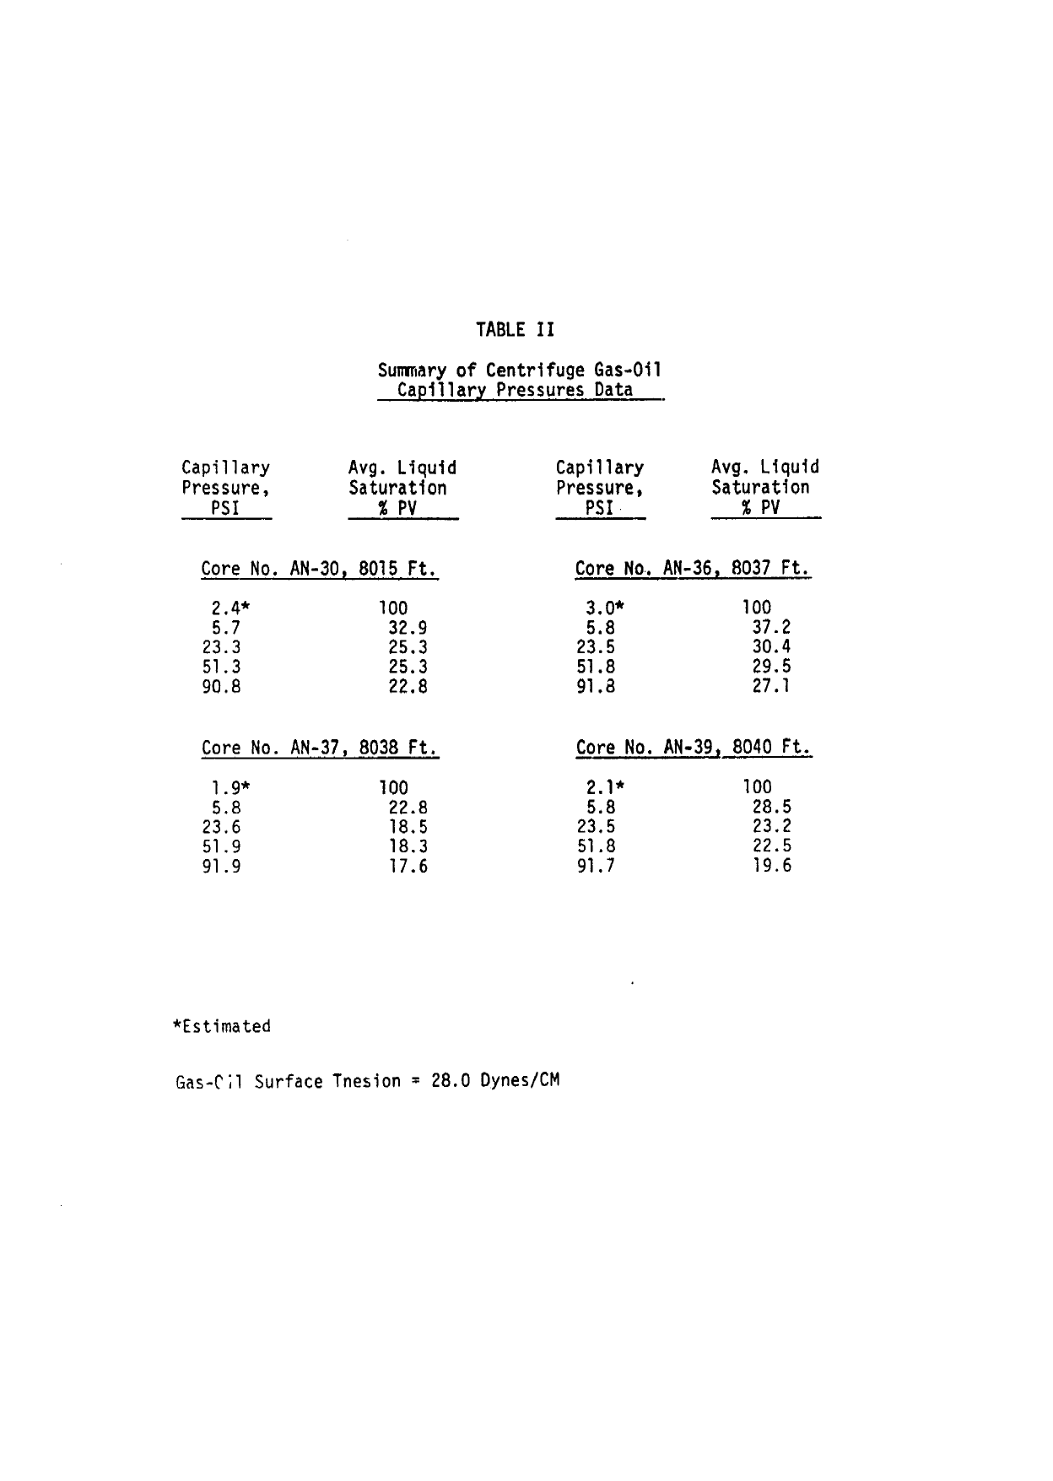
Extracted Page 7 — TABLE II (Gas-Oil Capillary Pressure)
Cores: AN-30, AN-36 | Duration: 12.94 min | Tokens: 2,512

Slide 20
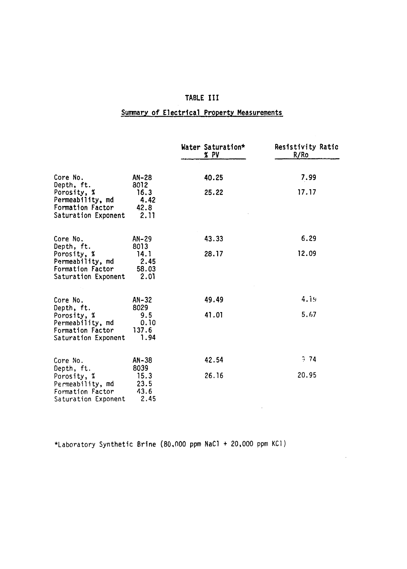
Extracted Page 8 — TABLE III (Electrical Properties)
Cores: AN-28, AN-29, AN-32, AN-38 | Duration: 15.88 min | Tokens: 2,878

Slide 21
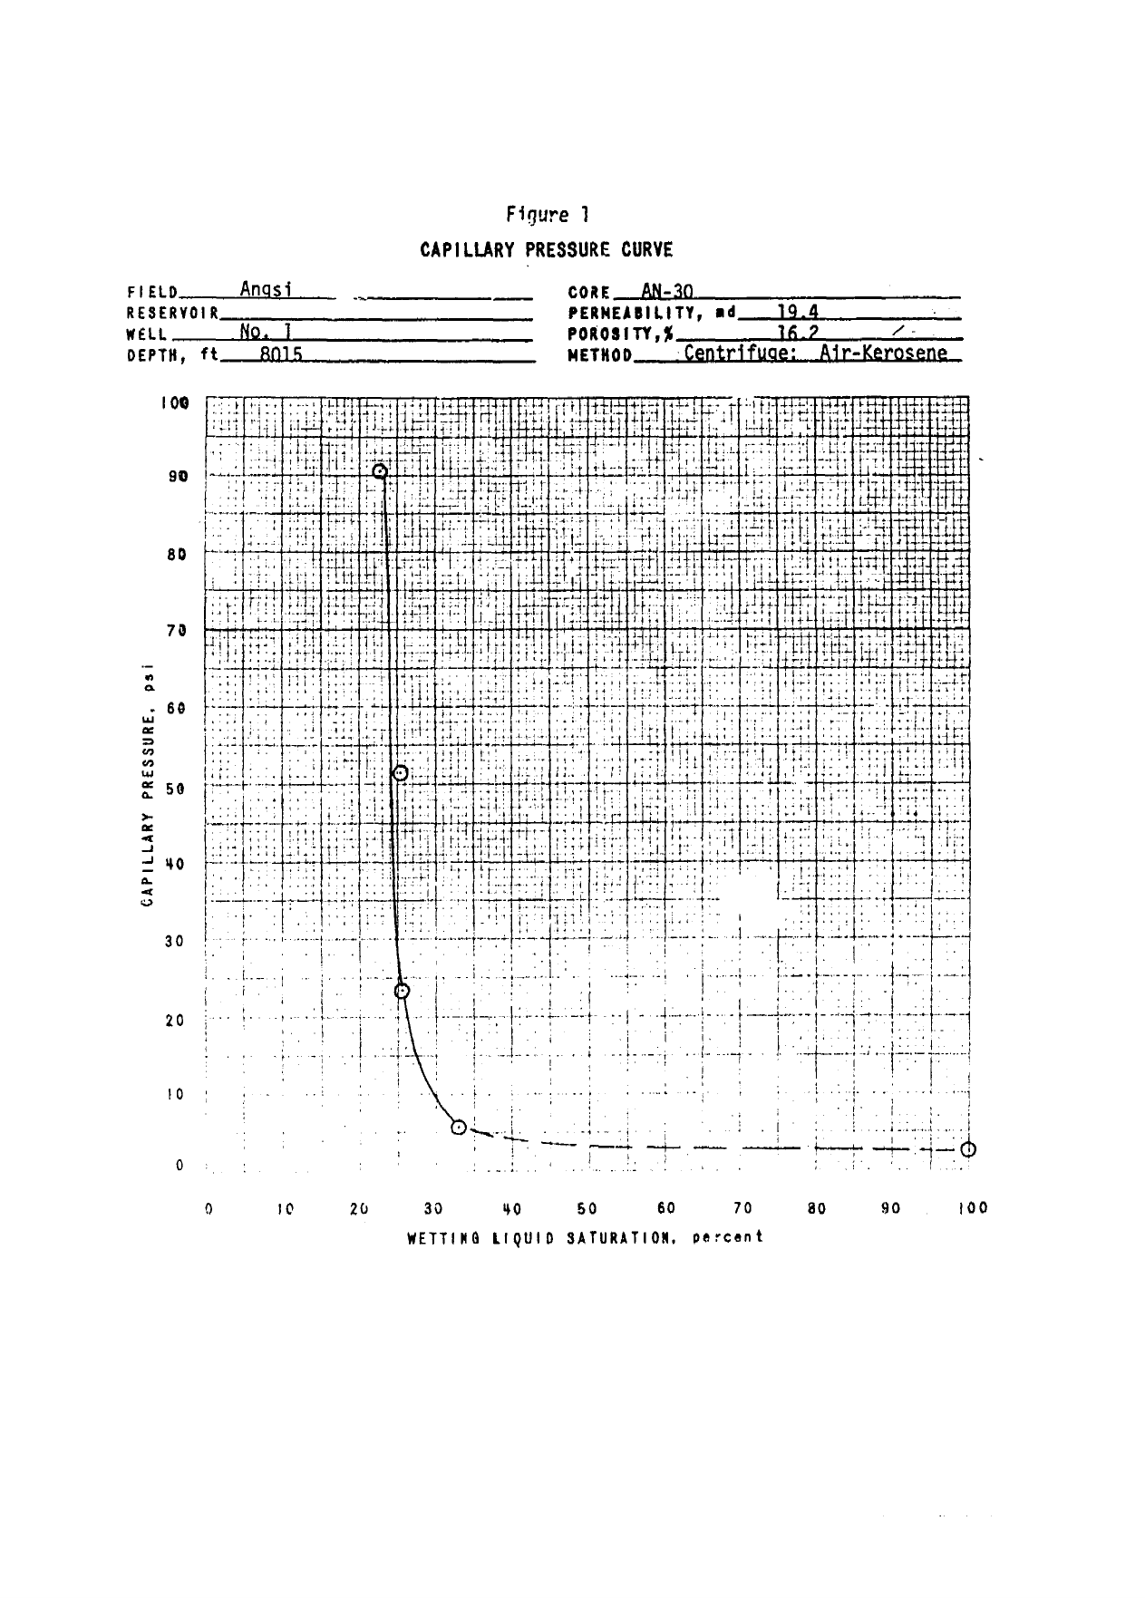
Extracted Page 9 — FIGURE 1 (Capillary Pressure Curve)
Core: AN-30, Depth: 8015 ft | Duration: 1.92 min | Tokens: 1,797

Slide 22
Extracted Structured Tables — Angsi 1 Core
Pages 6–8: olmOCR successfully extracted all 3 SCAL data tables in HTML format
TABLE I — Porosity & Permeability
TABLE II — Gas-Oil Capillary Pressure
TABLE III — Electrical Properties
Depth (ft) | Plug No. | Porosity (%) | Gas Perm. (md)
8012 | AN-28 | 16.3 | 4.42
8013 | AN-29 | 14.1 | 2.45
8015 | AN-30 | 16.2 | 19.4
8016 | AN-31 | 15.4 | 7.99
8029 | AN-32 | 9.5 | 0.10
8032 | AN-33 | 14.2 | 6.00
8034 | AN-34 | 17.0 | 50.2
8036 | AN-35 | 14.9 | 23.3
8037 | AN-36 | 14.4 | 9.17
8038 | AN-37 | 15.9 | 51.8
8039 | AN-38 | 15.3 | 23.5
8040 | AN-39 | 16.4 | 37.1
Pc (PSI) AN-30 AN-30 | Liq Sat% AN-30 AN-30 | Pc (PSI) AN-36 AN-36 | Liq Sat% AN-36 AN-36
2.4* | 100 | 3.0* | 100
5.7 | 32.9 | 5.8 | 37.2
23.3 | 25.3 | 23.5 | 30.4
51.3 | 25.3 | 51.8 | 29.5
90.8 | 22.8 | 91.8 | 27.1
1.9* | 100 | 2.1* | 100
5.8 | 22.8 | 5.8 | 28.5
23.6 | 18.5 | 23.5 | 23.2
51.9 | 18.3 | 51.8 | 22.5
91.9 | 17.6 | 91.7 | 19.6
Core | Depth (ft) | Por. (%) | Perm. (md) | FF | Sat. Exp.
AN-28 | 8012 | 16.3 | 4.42 | 42.8 | 2.11
AN-29 | 8013 | 14.1 | 2.45 | 58.03 | 2.01
AN-32 | 8029 | 9.5 | 0.10 | 137.6 | 1.94
AN-38 | 8039 | 15.3 | 23.5 | 43.6 | 2.45
* Estimated | FF = Formation Factor | Sat. Exp. = Saturation Exponent | Brine: Lab Synthetic (80,000 ppm NaCl + 20,000 ppm KCl) | Gas-Oil Surface Tension = 28.0 Dynes/CM

Slide 23
Extraction Results — Duyong Deep 1
Document: SPECIAL CORE ANALYSIS OF ROTARY SIDEWALL CORES (PETRONAS CARIGALI / UZMA ENGINEERING) | 38 pages extracted
Page | Duration | Tokens | Notes
1 | 4.9 min | 1,753 | Title page
2 | 10.3 min | 1,834 | Cover page
3 | 19.1 min | 2,094 | Table of Contents
4 | 26.5 min | 2,242 | Introduction, objectives, samples
5 | 25.0 min | 2,209 | Samples & Analyses table
6 | 24.1 min | 2,120 | SCAL Introduction & Results summary
7 | 32.4 min | 2,375 | Tables 1 & 2 – Formation Resistivity Factor
8 | 23.9 min | 2,184 | Table 3 – Air-Brine Capillary Pressure
9 | 12.6 min | 1,917 | Table 4 – CEC
10 | 1.6 min | 1,681 | Blank / spacer page
11 | 25.9 min | 2,179 | Table 5a – MICP (3184 m)
12 | 1.3 hrs | 3,092 | Table 5b – MICP (3528 m) ★ Complex
13 | 39.0 min | 2,581 | Table 5c – MICP (3576 m)
14 | 21.4 min | 2,085 | Table 5d – MICP (3598.5 m)
15 | 2.9 hrs | 5,778 | Graph 1 – FRF (3184 m) ★★ Very complex
16 | 59.1 min | 3,071 | Graph 2 – FRF (3528 m)
17 | 3.2 hrs | 5,775 | Graph 3 – Capillary Pressure ★★ Very complex
18 | 1.1 hrs | 3,201 | Graph 4a – MICP Linear
19 | 3.3 hrs | 5,774 | Graph 4b – MICP Linear ★★ Very complex
20 | 1.3 hrs | 3,197 | Graph 4c – MICP Linear
21 | 3.4 hrs | 5,767 | Graph 4d – MICP Linear ★★ Very complex
22 | 1.3 hrs | 3,331 | Graph 5a – MICP Semilog
23 | 3.9 min | 1,682 | Graph 5b
24–38 | ~2.5 hrs | ~28,908 | Graphs 5c–6d, Pore Size Distribution
TOTAL: 38 pages | 25.5 hrs | 95,039 tokens | 4 samples (depths 3184–3598.5 m) | Complex graph pages 15, 17, 19, 21 — each 2.9–3.3 hrs

Slide 24
Extraction Results — Pegaga-2
Document: RELATIVE PERMEABILITY NUMERICAL INTERPRETATION (MDC Oil & Gas SK320 / Senergy International, Nov 2015) | 49 pages extracted
Page | Duration | Tokens | Notes
1 | 8.3 min | 1,732 | Title page
2 | 5.8 min | 1,732 | Cover page
3 | 8.9 min | 1,817 | Executive Summary
4 | 12.6 min | 1,931 | SCAL Flow Chart (Fig. 1)
5 | 23.3 min | 1,932 | Contents
6 | 26.9 min | 2,214 | Introduction – test principles
7 | 45.4 min | 2,664 | Rel. Perm. Test Procedure + Sample table ★ Complex
8 | 9.1 min | 1,847 | Test procedure (continued)
9 | 46.9 min | 2,586 | Coreflood simulation intro ★ Complex
10 | 25.2 min | 2,102 | Sample 2-015 test setup
11 | 8.8 min | 1,796 | History matching intro
12 | 14.8 min | 1,958 | Sample 2-015 fit results
13 | 26.1 min | 1,901 | kr curves – Sample 2-015
14 | 1.1 hrs | 2,865 | History matching tables ★ Complex
15 | 10.5 hrs | 3,819 | Sample 2-019 large data table ★★★ Extreme
16 | 2.5 hrs | 4,255 | Sample 2-019 (continued) ★★ Very complex
17 | 24.6 min | 2,102 | Sample 2-019 results
18 | 15.7 min | 1,866 | Sample 2-023 setup
19 | 18.4 min | 1,927 | Sample 2-023 history matching
20 | 7.0 min | 1,903 | Sample 2-023 results
21 | 1.3 hrs | 2,863 | Sample 2-029 tables ★ Complex
22 | 2.3 hrs | 3,960 | Sample 2-029 (continued) ★★ Very complex
23 | 2.8 hrs | 4,172 | Sample 2-029 results ★★ Very complex
24 | 25.1 min | 2,067 | Sample 2-029 kr curves
25–34 | ~2.1 hrs | ~19,826 | Samples 2-033 (pp.25–34)
35 | 2.4 hrs | 3,965 | Data averaging – normalization ★★ Very complex
36 | 2.7 hrs | 4,230 | Normalized kr curves ★★ Very complex
37 | 1.9 hrs | 3,533 | References / discussion ★ Complex
38–42 | ~55.3 min | ~9,250 | Appendix pages
43 | 2.5 hrs | 4,048 | Appendix – large table ★★ Very complex
44 | 2.5 hrs | 4,063 | Appendix (continued) ★★ Very complex
45–49 | ~1.4 hrs | ~9,687 | Appendix pages 45–49
TOTAL: 49 pages | 49.1 hrs | 122,934 tokens | 5 samples (depths 2511–2516 m) | Page 15 alone: 10.5 hrs — largest single-page extraction in this benchmark

Slide 25
Extraction Benchmark — Three SCAL Documents
olmOCR ADE pipeline performance across document types, complexity, and size
Metric | Angsi-1 Core (ESSO, 1974) | Duyong Deep-1 (PETRONAS, ~2014) | Pegaga-2 (MDC/Senergy, 2015)
Document type | Core Analysis Report | Special Core Analysis (SCAL) | Rel. Perm. Numerical Interp.
Total pages | 17 | 38 | 49
Total duration | 68.1 min | 25.5 hrs | 49.1 hrs
Total tokens | 33,380 | 95,039 | 122,934
Avg tokens / page | 1,964 | 2,501 | 2,509
Avg duration / page | 4.0 min | 40.2 min | 60.1 min
Fastest page | Page 1: 0.9 min | Page 10: 1.6 min | Page 2: 5.8 min
Slowest page | Page 8: 15.9 min | Page 21: 3.3 hrs | Page 15: 10.5 hrs
Pages > 1 hr | None | Pages 15, 17, 19, 21 (4 pages) | Pages 15, 16, 22–23, 35–36, 43–44 (8 pages)
Tables extracted | 3 (HTML format) | 5+ SCAL data tables | 5 sample tables + kr curves
Figures labeled | 9 figures | 18+ graphs | 40+ kr curve plots
Extraction quality | ✓ All tables correct | ✓ All tables extracted | ✓ All pages extracted
Observation: Extraction time scales non-linearly with complexity. Simple text pages: ~5–20 min. Dense SCAL data tables: 20–80 min. Complex multi-panel graph pages: up to 10.5 hrs.

Slide 26
Extracted Structured Tables — Duyong Deep 1 (I)
Well Duyong Deep-1, Block PM12 | NOB = 560 psi | Saturant: 3,500 ppm synthetic brine
TABLE 1 — Formation Resistivity Factor at NOB Conditions
TABLE 4 — Cation Exchange Capacity
Sample ID | Depth (m) | Ka@NOB (mD) | φ@NOB (frac) | FRF (F) | m
2 | 3184.0 | 0.134 | 0.116 | 54.72 | 1.85
3 | 3528.0 | 0.011 | 0.091 | 81.05 | 1.83
4 | 3576.0 | 0.051 | 0.116 | 53.95 | 1.85
6 | 3598.5 | 0.037 | 0.101 | 68.07 | 1.84
Sample ID | Depth (m) | Porosity (%) | Grain Density (g/cc) | CEC (meq/100g) | Qv (meq/ml)
2 | 3184.0 | 11.6 | 2.66 | 1.1000 | 0.2230
3 | 3528.0 | 9.1 | 2.69 | 1.1600 | 0.3117
4 | 3576.0 | 11.6 | 2.67 | 1.0800 | 0.2198
6 | 3598.5 | 10.1 | 2.69 | 1.1200 | 0.2682

Slide 27
Extracted Structured Tables — Duyong Deep 1 (II)
Well Duyong Deep-1 | Formation Resistivity Factor & Resistivity Index at NOB Conditions
TABLE 2 — Formation Resistivity Factor & Resistivity Index (4 samples × 5 Sw measurements)
Sample | Depth (m) | Ka (mD) | φ (frac) | F | m | Sw (frac) | RI (I) | n
2 | 3184.0 | 0.134 | 0.116 | 54.72 | 1.85 | 1.000 | - | -
2 | 3184.0 | 0.134 | 0.116 | 54.72 | 1.85 | 0.933 | 1.139 | 1.89
2 | 3184.0 | 0.134 | 0.116 | 54.72 | 1.85 | 0.907 | 1.205 | 1.90
2 | 3184.0 | 0.134 | 0.116 | 54.72 | 1.85 | 0.884 | 1.263 | 1.90
2 | 3184.0 | 0.134 | 0.116 | 54.72 | 1.85 | 0.867 | 1.310 | 1.89
3 | 3528.0 | 0.011 | 0.091 | 81.05 | 1.83 | 1.000 | - | -
3 | 3528.0 | 0.011 | 0.091 | 81.05 | 1.83 | 0.939 | 1.126 | 1.88
3 | 3528.0 | 0.011 | 0.091 | 81.05 | 1.83 | 0.920 | 1.169 | 1.88
3 | 3528.0 | 0.011 | 0.091 | 81.05 | 1.83 | 0.908 | 1.197 | 1.87
3 | 3528.0 | 0.011 | 0.091 | 81.05 | 1.83 | 0.896 | 1.228 | 1.87
4 | 3576.0 | 0.051 | 0.116 | 53.95 | 1.85 | 1.000 | - | -
4 | 3576.0 | 0.051 | 0.116 | 53.95 | 1.85 | 0.933 | 1.139 | 1.87
4 | 3576.0 | 0.051 | 0.116 | 53.95 | 1.85 | 0.910 | 1.194 | 1.88
4 | 3576.0 | 0.051 | 0.116 | 53.95 | 1.85 | 0.892 | 1.241 | 1.89
4 | 3576.0 | 0.051 | 0.116 | 53.95 | 1.85 | 0.874 | 1.289 | 1.89
6 | 3598.5 | 0.037 | 0.101 | 68.07 | 1.84 | 1.000 | - | -
6 | 3598.5 | 0.037 | 0.101 | 68.07 | 1.84 | 0.939 | 1.126 | 1.88
6 | 3598.5 | 0.037 | 0.101 | 68.07 | 1.84 | 0.925 | 1.159 | 1.89
6 | 3598.5 | 0.037 | 0.101 | 68.07 | 1.84 | 0.912 | 1.190 | 1.88
6 | 3598.5 | 0.037 | 0.101 | 68.07 | 1.84 | 0.885 | 1.260 | 1.89
Saturant: 3,500 ppm | Resistivity of saturant: 1,500 Ω·m @ 77°F | NOB: 560 psi | F = a/φ^m | RI = a/Sw^n

Slide 28
Extracted Structured Tables — Duyong Deep 1 (III)
Well Duyong Deep-1 | Capillary Pressure & Pore Size Distribution
TABLE 3 — Air-Brine Capillary Pressure by Centrifuge (key Sw columns)
TABLE 5 — Pore Size Distribution Summary
Sample | Depth (m) | Ka (mD) | Phi (%) | Sw@1 psi | Sw@25 psi | Sw@50 psi | Sw@100 psi | Sw@200 psi
2 | 3184.0 | 0.134 | 11.6 | 100.0 | 97.2 | 92.1 | 83.7
3 | 3528.0 | 0.011 | 9.1 | 100.0 | 100.0 | 100.0 | 100.0
4 | 3576.0 | 0.051 | 11.6 | 100.0 | 100.0 | 100.0 | 100.0
6 | 3598.5 | 0.037 | 10.1 | 100.0 | 100.0 | 100.0 | 100.0
Sample ID | Depth (m) | Porosity (%) | Micro r<0.5 (%) | Meso 0.5-1.5 (%) | Macro r>1.5 (%)
2 | 3184.0 | 11.3 | 88.9 | 1.4 | 9.7
3 | 3528.0 | 9.3 | 86.2 | 0.8 | 13.0
4 | 3576.0 | 11.2 | 77.6 | 1.7 | 20.7
6 | 3598.5 | 10.0 | 80.4 | 0.0 | 19.6

Slide 29
Extracted Structured Tables — Pegaga-2 (I)
Pegaga-2, Malaysia | Hybrid USS G-W Drainage + O-W Centrifuge Imbibition Kr Tests
Table 1 — Sample Properties & Target / Achieved Swi
Sample ID | Depth (m) | Ka NCS (mD) | Porosity (%) | Target Swi (%) | Achieved Swi (%)
2-015 | 2511.1 | 2.46 | 18.6 | 20 | 20.5
2-019 | 2512.2 | 37 | 24.5 | 7.5 | 9.2
2-023 | 2513.4 | 9.93 | 22.87 | 15 | 16.4
2-029 | 2515.1 | 13.8 | 18.1 | 10 | 10.5
2-033 | 2516.16 | 21.6 | 25 | 5 | 7.4

Slide 30
Extracted Structured Tables — Pegaga-2 (II)
Corey model parameters extracted by olmOCR ADE | All 5 samples | Sendra™ history-matched
Drainage USS — Corey Model Parameters
Imbibition Centrifuge — Corey Model Parameters
Sample | Kw (mD) | Swir (frac) | Kg@Swir (mD) | Krg@Swir | Nw | Ng
2-015 | 1.63 | 0.205 | 0.062 | 0.593 | 4.55 | 2.5
2-019 | 26.7 | 0.092 | 28.2 | 1.05 | 5.85 | 2.52
2-023 | 5.76 | 0.164 | 5.6 | 0.97 | 5.42 | 2.2
2-029 | 5.48 | 0.105 | 5.97 | 1.09 | 5.9 | 2.33
2-033 | 13 | 0.074 | 16.6 | 1.27 | 6.15 | 2
Sample | Kg@Swir (mD) | Swir (frac) | Kw@Sgr (mD) | Sgr (frac) | Krg@Swir | Krw@Sgr | Nw | Ng
2-015 | 0.967 | 0.205 | 0.062 | 0.4665 | 1 | 0.0643 | 4.55 | 2.7
2-019 | 28.2 | 0.092 | 0.256 | 0.4665 | 1 | 0.346 | 5.85 | 2.75
2-023 | 5.6 | 0.092 | 0.459 | 0.412 | 1 | 0.082 | 5.42 | 2.4
2-029 | 5.97 | 0.105 | 2.2 | 0.245 | 1 | 0.369 | 5.90 | 2.28
2-033 | 16.6 | 0.074 | 4.84 | 0.21 | 1 | 0.292 | 6.15 | 2.08

Slide 31
Extracted Structured Tables — Pegaga-2 (III)
Sample 2-015 | Depth 2511.1 m | Ka = 2.46 mD | φ = 18.6% | Swir = 0.205 frac
Table 3.1.2 — Primary Drainage USS Relative Permeability Data (first 12 of 41 rows shown)
Swn (norm.) | Sw (drainage) | Krw | Sw (imbibition) | Krg
0.000 | 0.205 | 0.0E+00 | 0.205 | 1.00E+00
0.025 | 0.225 | 5.14E-08 | 0.225 | 9.39E-01
0.050 | 0.245 | 1.20E-06 | 0.245 | 8.80E-01
0.075 | 0.265 | 7.61E-06 | 0.265 | 8.23E-01
0.100 | 0.285 | 2.82E-05 | 0.285 | 7.68E-01
0.125 | 0.304 | 7.78E-05 | 0.304 | 7.16E-01
0.150 | 0.324 | 1.78E-04 | 0.324 | 6.66E-01
0.175 | 0.344 | 3.60E-04 | 0.344 | 6.18E-01
0.200 | 0.364 | 6.60E-04 | 0.364 | 5.72E-01
0.225 | 0.384 | 1.13E-03 | 0.384 | 5.29E-01
0.250 | 0.404 | 1.82E-03 | 0.404 | 4.87E-01
Full dataset in RESULTS/Pegaga2_Extracted_Tables.xlsx | Corey model: Nw = 4.55, Ng = 2.5 | Krg@Swir = 0.593

Slide 32
Feature / Property | Angsi-1 (12 spl) | Duyong Deep-1 (4 spl) | Pegaga-2 (5 spl) | Category
Porosity Phi% | YES | YES | YES | Rock Quality
Air Permeability Ka mD | YES | YES | YES | Rock Quality
Grain Density g/cc | YES | YES | — | Rock Quality
Formation Factor | YES | YES | — | Electrical
Saturation Exponent n | YES | — | — | Electrical
CEC meq/100g | — | YES | — | Electrical
Qv meq/ml | — | YES | — | Electrical
Swir (frac) | — | — | YES | Kr Endpoints
Sgr (frac) | — | — | YES | Kr Endpoints
Kg @ Swir (mD) | — | — | YES | Kr Endpoints
Kw @ Sgr (mD) | — | — | YES | Kr Endpoints
Corey Nw | — | — | YES | Kr Shape
Corey Ng | — | — | YES | Kr Shape
Gas-Oil Pc Centrifuge | YES | — | — | Pc
Air-Brine MICP Pc | — | YES | — | Pc
Full Kr Curves | — | — | YES | Kr Curves

Slide 33
Sample | Depth (m) | Phi (%) | Ka (mD) | Swir (frac) | Sgr (frac) | Kg@Swir (mD) | Kw@Sgr (mD) | Krg max | Krw max | Nw | Ng | Gas Rec. (%) | RQI
2-015 | 2511.1 | 18.6 | 2.46 | 0.205 | 0.4665 | 0.967 | 0.062 | 1.0 | 0.0643 | 4.55 | 2.7 | 41.3 | 0.114
2-019 | 2516.5 | 24.5 | 28.8 | 0.092 | 0.256 | 28.2 | 9.75 | 1.0 | 0.346 | 5.85 | 2.75 | 71.8 | 0.34
2-023 | 2517.7 | 22.9 | 6.6 | 0.164 | 0.412 | 5.6 | 0.459 | 1.0 | 0.082 | 5.42 | 2.4 | 50.7 | 0.169
2-029 | 2520.1 | 18.1 | 6.2 | 0.105 | 0.245 | 5.97 | 2.2 | 1.0 | 0.369 | 5.9 | 2.28 | 72.6 | 0.184
2-033 | 2521.4 | 18.1 | 16.6 | 0.074 | 0.21 | 16.6 | 4.84 | 1.0 | 0.292 | 6.15 | 2.08 | 77.3 | 0.301
Swn | Sw | Krw (Drainage) | Sw | Krg (Drainage)
0.000 | 0.205 | 0.000E+00 | 0.205 | 1.000E+00
0.025 | 0.225 | 5.14E-08 | 0.225 | 9.39E-01
0.100 | 0.285 | 2.82E-05 | 0.285 | 7.68E-01
0.200 | 0.364 | 6.60E-04 | 0.364 | 5.72E-01
0.400 | 0.523 | 1.55E-02 | 0.523 | 2.79E-01
0.600 | 0.682 | 9.79E-02 | 0.682 | 1.01E-01
0.800 | 0.841 | 3.62E-01 | 0.841 | 1.79E-02
1.000 | 1.000 | 1.00E+00 | 1.000 | 0.000E+00
Sample | Swir | Sgr | Nw | Ng | Krw_max
2-015 | 0.205 | 0.4665 | 4.55 | 2.7 | 0.0643
2-019 | 0.092 | 0.256 | 5.85 | 2.75 | 0.346
2-023 | 0.164 | 0.412 | 5.42 | 2.4 | 0.082
2-029 | 0.105 | 0.245 | 5.9 | 2.28 | 0.369
2-033 | 0.074 | 0.21 | 6.15 | 2.08 | 0.292

Slide 34
Sample | Depth (ft) | Ka (mD) | Phi (%) | Pc_entry (psi) | Pc_max (psi) | Swir @ Pc_max (%) | Pc_entry Run2 | Notes
AN-30 | 8015 | 19.4 | 16.2 | 2.4 | 91.9 | 22.8 | ~1.9 | ~2 runs
AN-36 | 8037 | 9.17 | 14.4 | 3.0 | 91.7 | 19.6 | ~2.1 | ~2 runs
Pc_inj (psia) | Hg_Sat (frac Vp) | Sw_wetting (frac Vp) | J-Function
333.7 | 0.0706 | 0.9294 | 0.1904
427.2 | 0.2079 | 0.7921 | 0.2438
503.1 | 0.2765 | 0.7235 | 0.2871
623.2 | 0.3667 | 0.6333 | 0.3556
709.9 | 0.4216 | 0.5784 | 0.4051
804.8 | 0.4667 | 0.5333 | 0.4592
904.9 | 0.4922 | 0.5078 | 0.5164
1004.0 | 0.5158 | 0.4842 | 0.5729
Well | Sample | Depth | Fluid | Pc_entry | Method
Angsi-1 | AN-30 | 8015 ft | Gas-Oil | ~2.4 | Centrifuge
Angsi-1 | AN-36 | 8037 ft | Gas-Oil | ~3.0 | Centrifuge
Duyong | D-002 | 3184 m | Air-Hg | 334 | MICP
Duyong | D-003 | 3528 m | Air-Hg | ~200 | MICP
Duyong | D-004 | 3576 m | Air-Hg | ~250 | MICP
Duyong | D-006 | 3599 m | Air-Hg | ~280 | MICP
Pegaga | 2-015 | 2511 m | Air-Hg | n/a | HPMI-ext

Slide 35
Sheet Name | Rows | Cols | Contents
Corey_Parameters | 5 | 19 | Summary: Swir, Sgr, Nw, Ng, RQI, FZI, Gas Recovery
Drn_2-015 … Drn_2-033 | 5×41 | 5 | Drainage Krw & Krg vs Sw (per sample)
Imb_2-015 … Imb_2-033 | 5×41 | 5 | Imbibition Krw & Krg vs Sw (per sample)
Normalized_Kr_Combined | 410 | 15 | Long-format ML table: Sample+Phi+Ka+Swn+Krw+Krg+log10Ka+RQI

